Slide 1
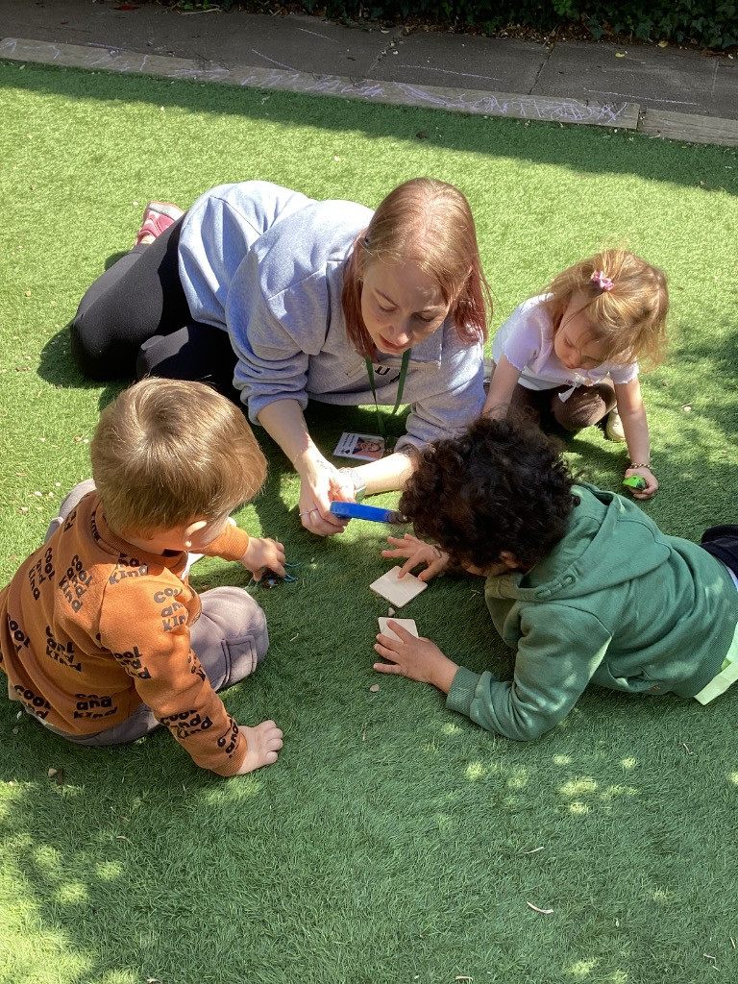


Special Educational Needs Information Report
How we support children with special needs and disabilities and their families at Ronald Tree Nursery School
2025-2026

Slide 2
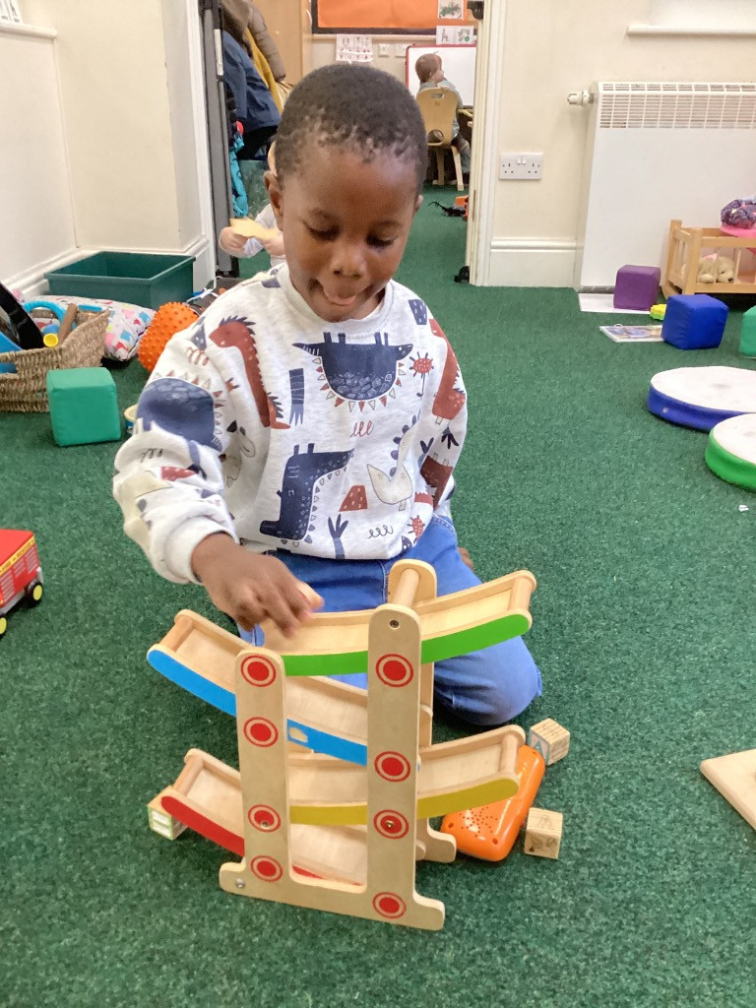
At Ronald Tree, we recognise that every child is different and we embrace the fact that all of their learning journeys are unique!
This is reflected in our provision with pupils with special educational needs or disabilities.
The four broad identified areas of need are:
Communication and interaction
Cognition and learning
Social, emotional and mental health
Sensory and physical needs

Slide 3

Our SEND figures for 25-26
By the summer of 2026, we had a total of 126 children across all our rooms at Ronald Tree.
Of those children, 34 were on our SEND provision map, which meant they required additional or different support to access our curriculum.
We had 10 pupils receive a final Education Health Care Plan after referral from our SEND team. We have referred a further 5 children who will be staying with us next academic year.
We had 6 children with a diagnosis of ASD
Our main areas of need were: communication or social, emotional and mental health

Slide 4
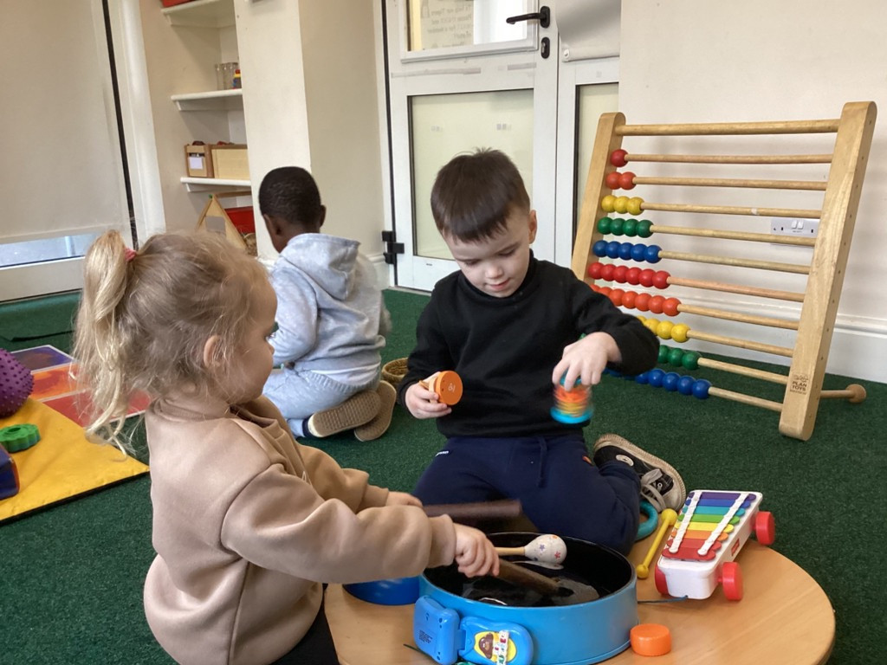
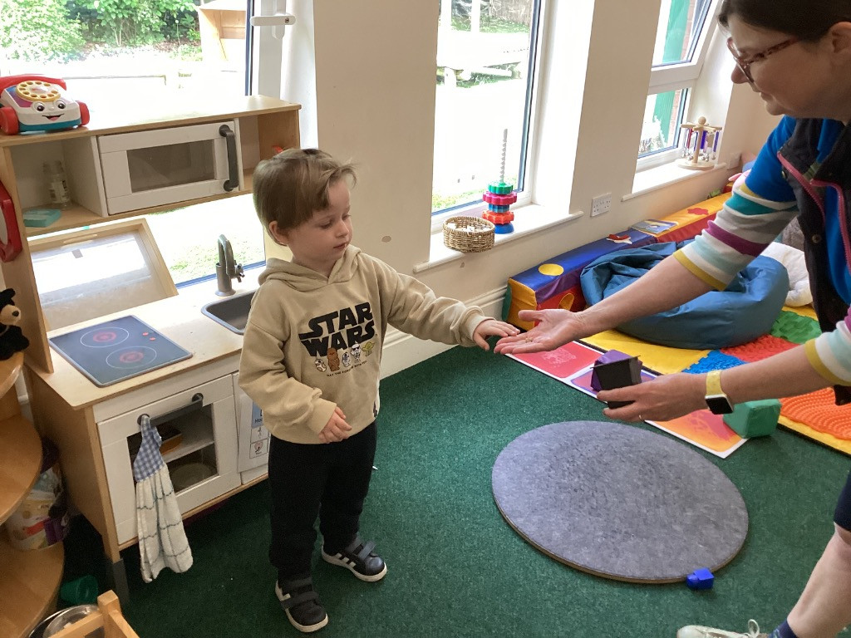
What should I do if I think my child has Special Educational Needs?
Firstly, don’t panic or worry or keep your thoughts to yourself.
We are here to listen and support you in any way we can.
Talk to your child’s key worker, to our Special Educational Needs coordinator Deb, or to Jackie, our teacher. We will be able to talk through your concerns, offer guidance and help you to seek appropriate support if needed.
You may also want to speak to other professionals such as your GP or your health visitor

Slide 5
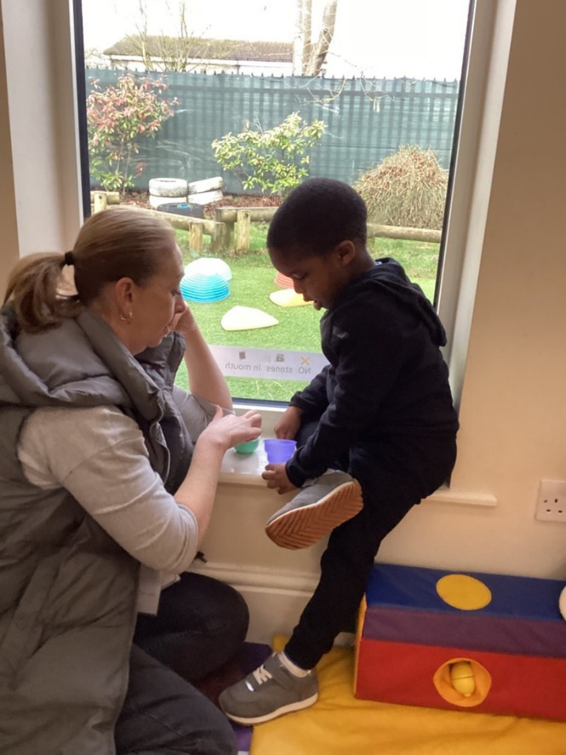
How does the nursery know if a child needs extra help?
At Ronald Tree we have a professional, confident team of practitioners. Pupil observation happens all the time and we use these observations to assess progress and attainment against national guidance documents.
If a pupil is working at a level significantly below expectations for their age or is not showing progress in particular areas of development, we may assess them using more focussed tools such as the Developmental Profile provided by our Special Needs support service or the Communication and Language toolkit ’WellComm’
We often ask parents to complete these alongside us as we know children show different abilities in different situations.
We will always talk with families before drawing any conclusions on whether or not a child needs additional support in the nursery.
Some children arrive with support already in place having been referred by their health visitor or doctor

Slide 6
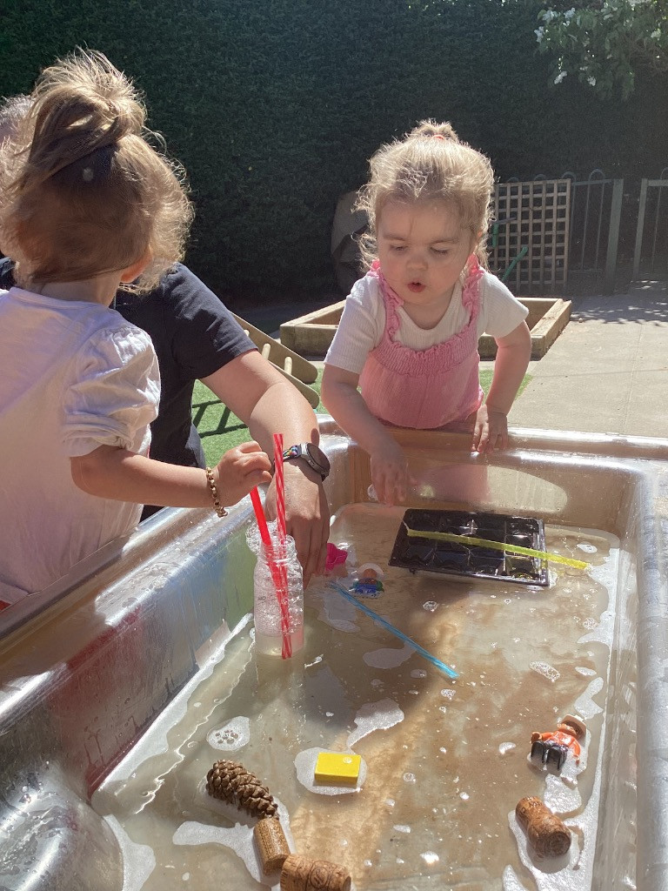
How will both school and I know how my child is doing?
We will have an early discussion with families and regular meetings and catch-ups after that. These conversations will ensure that:
Everyone develops a good understanding of the child’s strengths and difficulty
We take into account family concerns and any recommendations by professionals
Everyone is clear on the agreed outcomes for the child
Parents are also invited to chat to staff and key workers on a daily basis as they drop off and collect their child.
Observations are shared on Tapestry. Parents are strongly encouraged to share their views of the child on here too
School will continue to observe your child and assess their progress towards individual objectives.

Slide 7
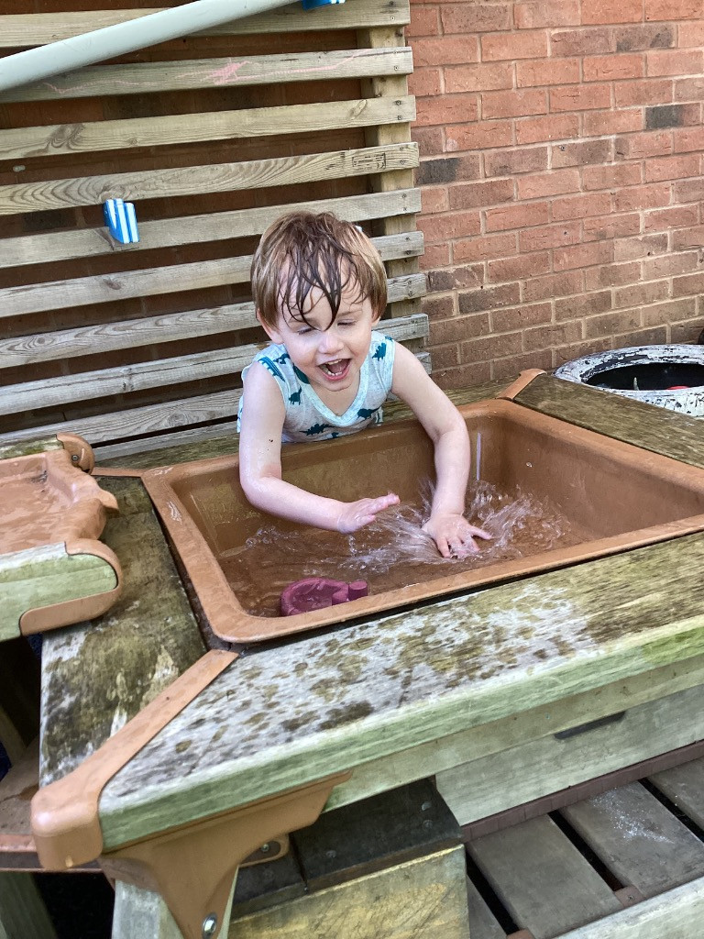
How will the curriculum be matched to my child’s needs?
Your child will be able to access all areas of the curriculum at Ronald Tree.
We follow the ‘Graduated Approach’ – this means we follow a cycle of: Assess-Plan-Do-Review
If your child is identified as having SEND, we will provide support that is ‘additional to or different from’ our regular differentiated provision.
Your child will have their own targets and may work with one of our SEND staff team members. This work could involve extra support in the classroom or one to one or small group work in our specially set out ‘Tiger room’
Depending on need, some children may remain in our younger, smaller Teddy Bear room to ensure their safety and well-being needs are met
Where external agencies are involved, we work closely together with them and your family.
Ongoing observations guide us throughout.
Whatever stage of their learning journey they are on, support will be given at their pace and level of need to help them progress to the next step.

Slide 8
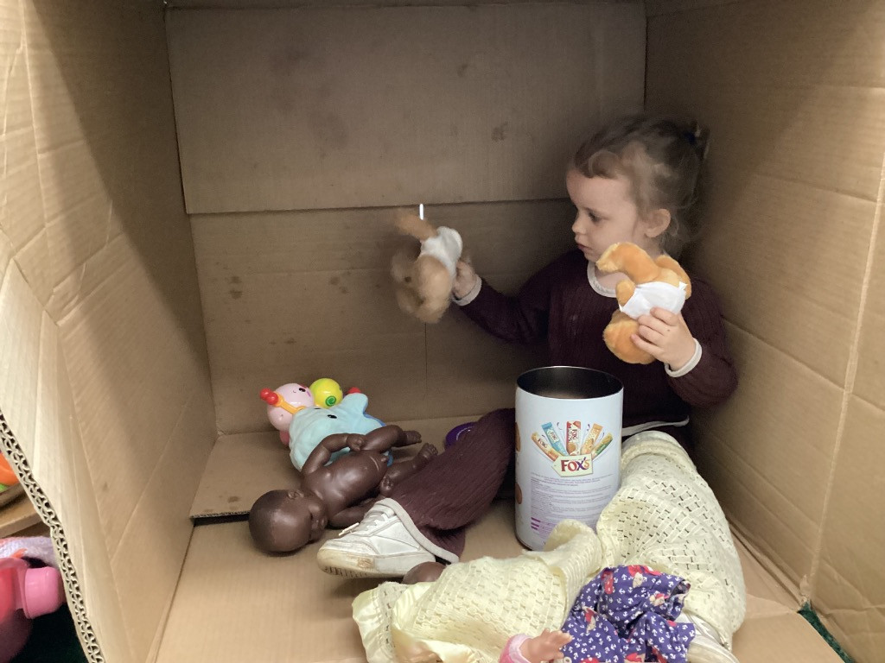
How are the school resources allocated and matched to the child’s need?
We have an experienced, passionate team of SEND specific practitioners who work closely with our pupils with SEND and their families. We also offer training to all our practitioners and provide opportunities to share good practice.
The team are trained to support a number of individual needs and Jackie, our qualified teacher adapts planning and objectives in light of observations. She has allocated time outside of the classroom to complete this work.
We work very closely with the LA Special Needs Support Service and are advised by the LA Speech and language team who provide individualised objectives and guidance for individual pupils.
Our pupils with an EHCP receive funding from the LA which enables us to employ an additional member of staff to work with them as well as employ a speech and language therapist to assess pupils, work with them and train staff.
We have a separate play space we named the ‘Tiger Room’. In here, we can take children for small group work and one to one tasks away from the hustle and bustle of the main nursery rooms. This has been invaluable in building our capacity to support children with complex learning differences and is an established part of our nursery since it’s implementation in 2022.

Slide 9
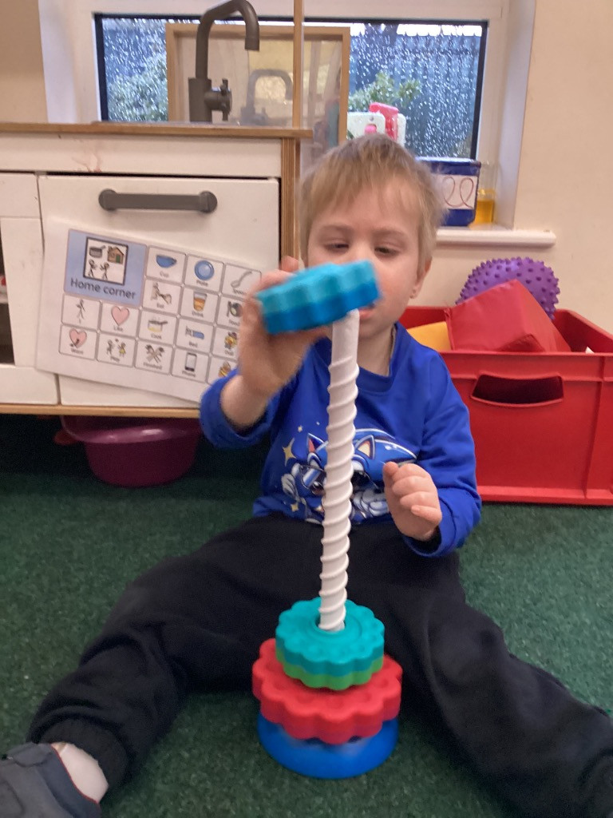
How does the school judge if the support has had an impact?
Children’s progress will be assessed against age related expectations three times during the year. Assessments which are broken down into smaller stages (Portage assessments, speech and language assessments and Tapestry assessments) may be used for these children to assess their progress more appropriately.
Some pupils with SEND will have an Individual Play Plan with their objectives on there. These are reviewed termly as part of our cycle and new targets are set. However, all of the staff here follow a ‘Planning in the moment’ approach – so we don’t wait until a termly review to move children forward if we can see their targets have been met.
We complete focus child reports, the WellComm speech and language tool and further Tapestry observations on our pupils to track progress and engagement.
The head teacher, Deb, reports on the progress of our pupils with SEND three times a year to our Governing body.

Slide 10
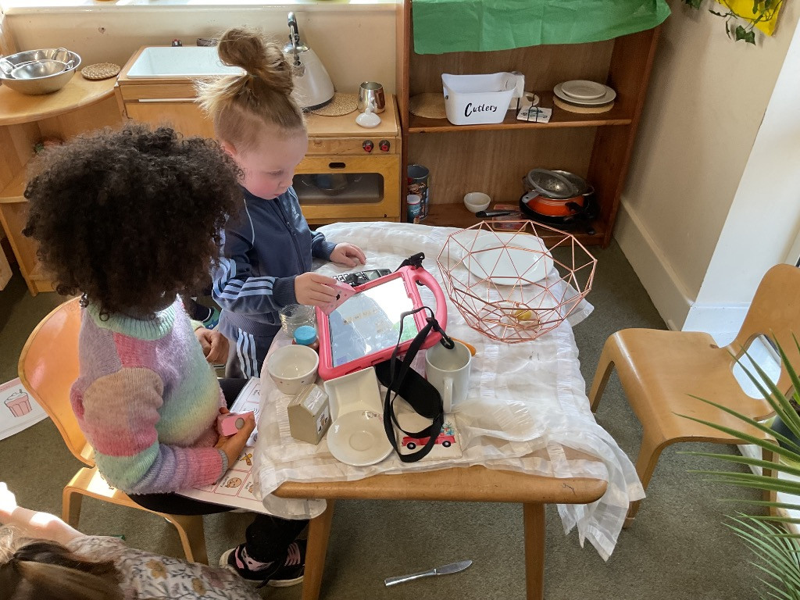
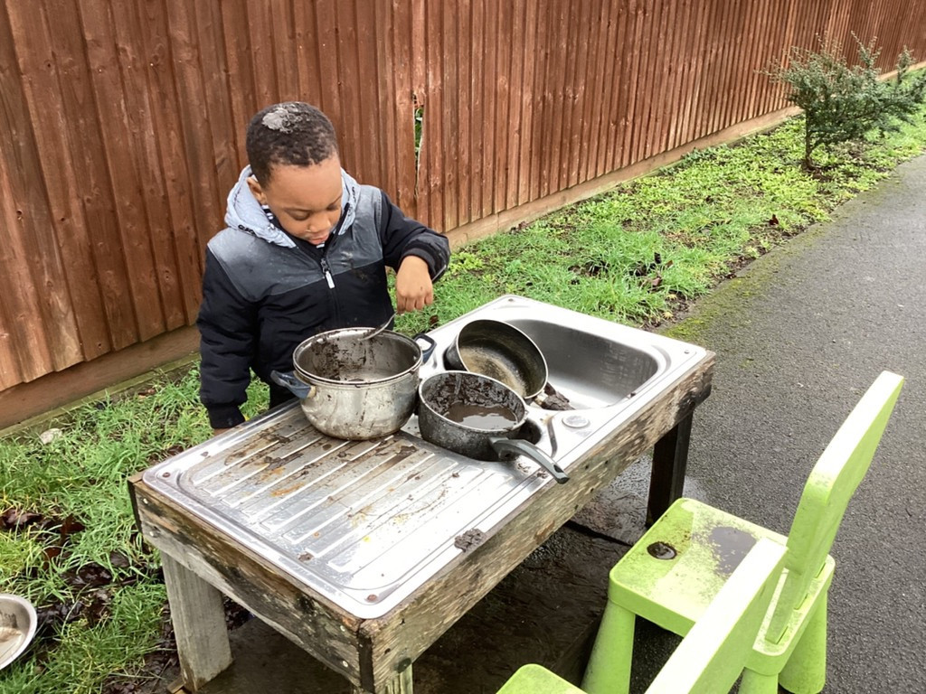
How will my child be included in all of the learning opportunities at Ronald Tree?
All children have access to the range of activities in nursery. All children mix with one another during the nursery session, choosing their own friendship groups and activities.
Children identified as having SEND may engage in small group work with an Early Years Practitioner in which those children without SEND may be included in the group to encourage social skills or cognitive development.
During special ‘events’ such as trips out or visitors coming in to the setting, we will work with families to ensure as much participation as possible – by asking a family member to join us for example. However, the child’s well-being is of ultimate importance to us and we may decide together that some events could overwhelm a child and offer an alternative.
Safeguarding procedures are in place to ensure the safety of all children.
Those children with additional needs are supported to develop alternative means of communication such as pictures or sign to express their emotions.
All children are treated respectfully and inclusively.
Our school Accessibility plan can be found on our website. We are a one storey building with appropriate access to all areas.

Slide 11
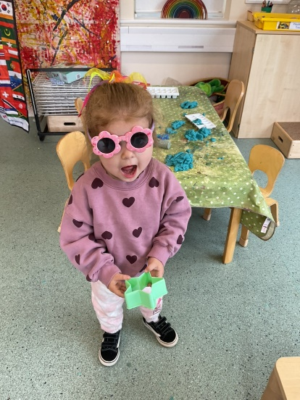
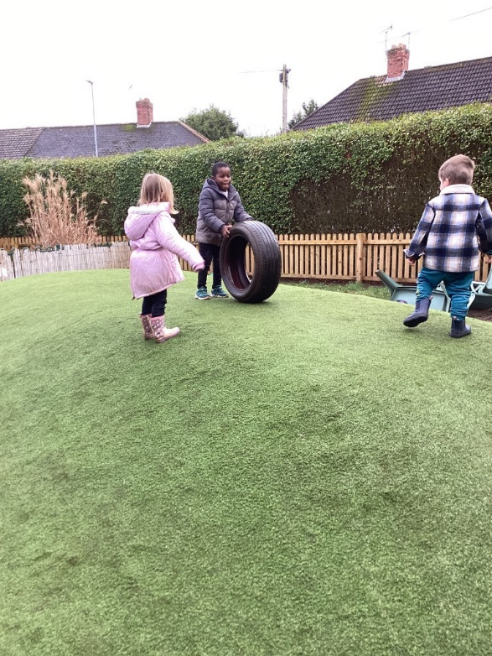
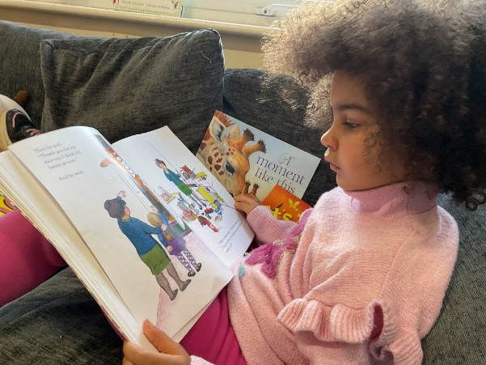
Family views from this year
Your guidance and encouragement have helped my son learn, grow and gain confidence.
My two years here have been filled with such happiness and I have learnt so much!

Slide 12
What training and expertise do the staff have?
All key workers and SEND TAs at Ronald Tree are Cache Level 3 Early Years Educator trained
They have experience and SEND specific training which is constantly revised and updated
Jackie and Deb are qualified teachers with many years of experience between them. Deb completed the National SENCO accreditation in July 2022.
Many of our practitioners have worked with Kristina Smith – a qualified Speech and Language therapist to support all children in nursery communicate. Our January 24 training day was led by Kristina and Vanessa Gilbert (Team Teach) and focussed on meaningful interactions .We have completed National College training on self-regulation and autism.
We have regular staff meetings with SEND as our focus and discuss individual strategies and support in our weekly planning meetings
We work very closely with SSS experts who advise us and measure impact
One member of staff has level 2 British Sign Language and training in the use of cochlear implants. Another one completed the ‘Signalong’ training run by NNC in Spring 2024.

Slide 13
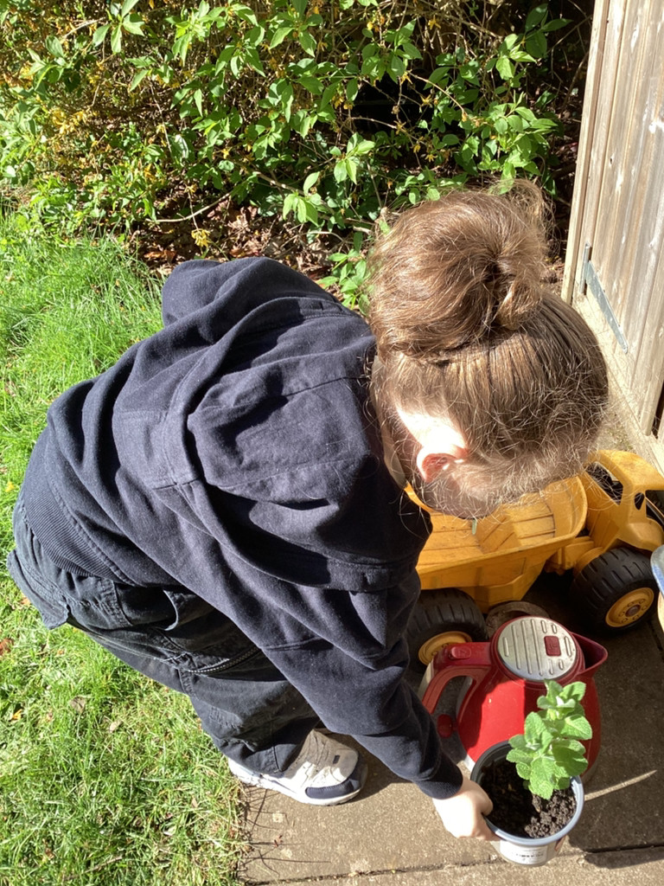
How accessible is the school both indoors and outdoors?
The building is on one level with doors of appropriate width for wheelchairs
The school has an accessible toilet for adults, child sized toilets for the pupils, including one with a support rail
Where specialist equipment is needed, the nursery will liaise with parents and outside agencies to secure this and may access specific funding
All children are actively encouraged to use the outdoor provision which is fully accessible and visually risk assessed each day

Slide 14
What specialist services do the school work with?
SEND Early Years Team (often known as Portage)
Speech and Language Team
Educational Psychologists
Health Visitors
Community Pediatrician
Social Workers

Slide 15
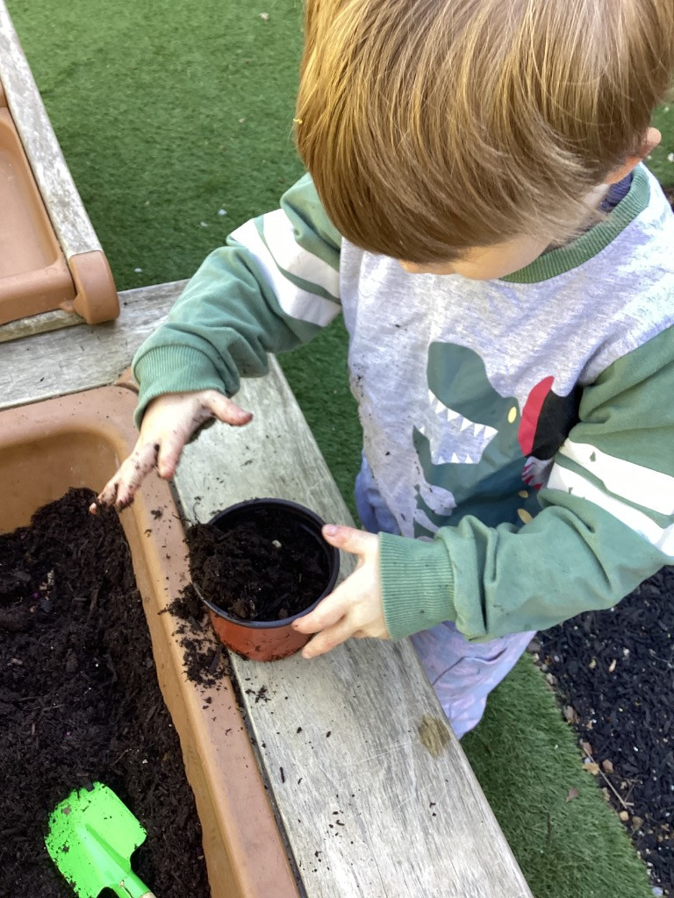
How will the school support my child when transferring schools or classes?
Prior to children starting nursery, key workers carry out home visits where parents can discuss any concerns
Parents may need to stay with their child for initial settling-in sessions and the length of time can be adjusted to suit individual need
Staff talk with families when it’s time to move a child from one room to another. Children make several visits to their new room and meet their new staff
Reception teachers from primary schools may visit in the summer term to meet the child and talk to staff
Staff from Ronald Tree will hold transition meetings with the new schools and share the SEND support plan for your child with the new team
Visits to the new setting are encouraged

Slide 16
Who can I contact for further information or if I want to complain about SEND provision?
Families should always approach their key worker with any complaint or for more information.
If more help is needed, speak to Deb, the head teacher or contact Mike Leeke– our chair of Governors.
A copy of the school Complaints Policy is available on our website or from the school office

Slide 17

The Local Offer
Website:
Local Offer, SEND and EHC plans | North Northamptonshire Council
Service description:
The Local Offer is a website which publishes information about services available for children and young people (aged 0-25) with special educational needs and disabilities.
Services on the website include: health services, schools, social and leisure activities, social care services, finance and funding, parent support groups, early years settings, specialist housing, specialist equipment, employment, transport and more.

