Slide 1

Our Self Evaluation Form
24-25
We play, learn and grow, inspiring our children to be happy,
lifelong learners

Slide 2
Overall Effectiveness
Ronald Tree Maintained Nursery School wAs inspected in July 2024 and met all the Ofsted criteria to be a good school.
We believe we also show many outstanding elements, in particular the behaviour and attitudes of our pupils and in their personal development. This is inspired by our passionate, knowledgeable and experienced team of professionals who live and breathe our values and always put the needs of the children first.
Every child, and their family, are valued at this school. Adults know the children very well. They treat each one as an individual, including children with special educational needs and/or disabilities OFSTED report 2024

Slide 3
Our identified strengths:
Warm, welcoming setting with knowledgeable staff and high levels of well-being
Provision for those pupils with SEND
Enrichment activities varied and well led
Safeguarding our pupils
Communication skills for all pupils
Working with families - including in school Sessions and weekly support off site
Our areas to further develop:
New curriculum monitoring children’s care of the learning environment
Staff supervision and cpd

Slide 4
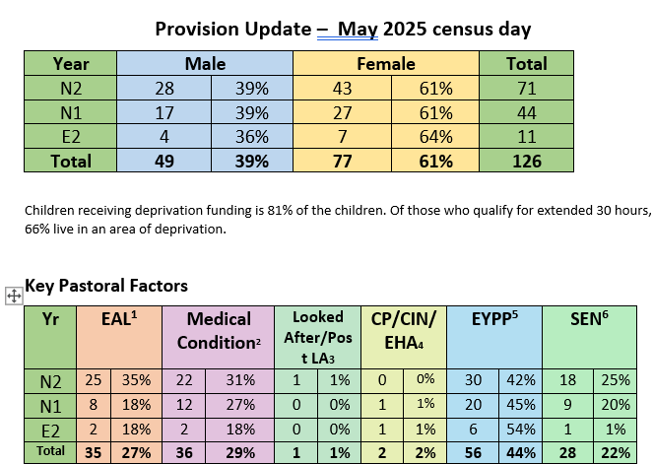
Our context
We have a long-standing commitment to providing high quality provision and family support to the children in our local area. We are located in an area recognised as high in deprivation. We have always ensured that those eligible for funded places do not have to pay a penny extra for their child and those who need a little more are able to buy extra hours at the lowest cost possible. We are proud of this social responsibility and believe our setting offers aspirational learning and a culture of self-belief and positivity.
We are fortunate to be exclusively ‘Early Years’ and, as such, we can focus wholly on the developmental milestones for children aged 0-5. We believe in a playful, holistic way of working with the children and have great outdoor areas and different room bases for the children to play in. We have developed a 4th play-space for those children who find the nursery classrooms a little overwhelming.
We have part-time and full-time places and have a full, busy breakfast club, lunch club and after-school provision. Numbers in the nursery increase over the year as we offer January and April intakes when children become eligible, however, these are increasingly being filled earlier as funding entitlements change. There is not a lot of pupil movement, most children stay with us until they are ready to transition to Primary school.

Slide 5
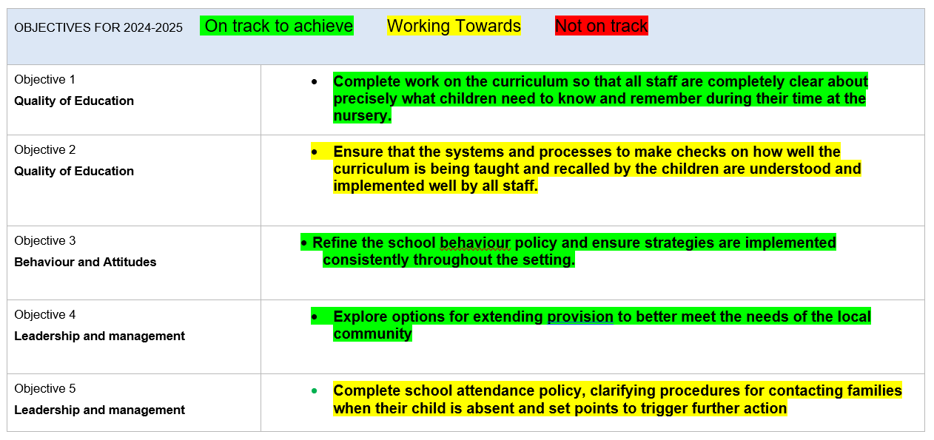
School Development
July 2024 Ofsted Recommendations
The school’s work to refine the curriculum is not yet complete. The different documents staff use to plan and deliver the curriculum do not completely link together in a cohesive manner. This means that the sequence of learning that the children receive is not as seamless as it could be. The school needs to complete it’s work on the curriculum so that all staff are completely clear about precisely what children need to know and remember during their time at the nursery
The checks that the school makes on how well the early years curriculum is being implemented are at an early stage. Some staff are developing the leadership knowledge and expertise to make these checks. Therefore, in pockets, the curriculum is not fully implemented as intended. The school should ensure that the systems and processes to make checks on how well the curriculum is being taught and recalled by the children are understood and implemented well by all staff.

Slide 6
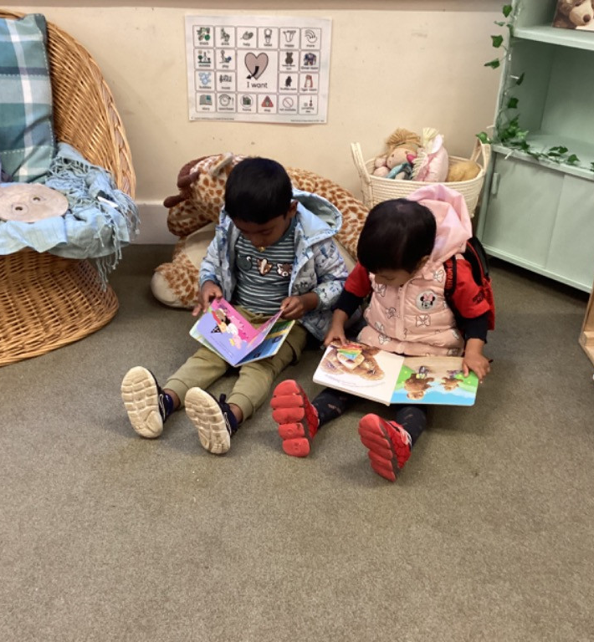
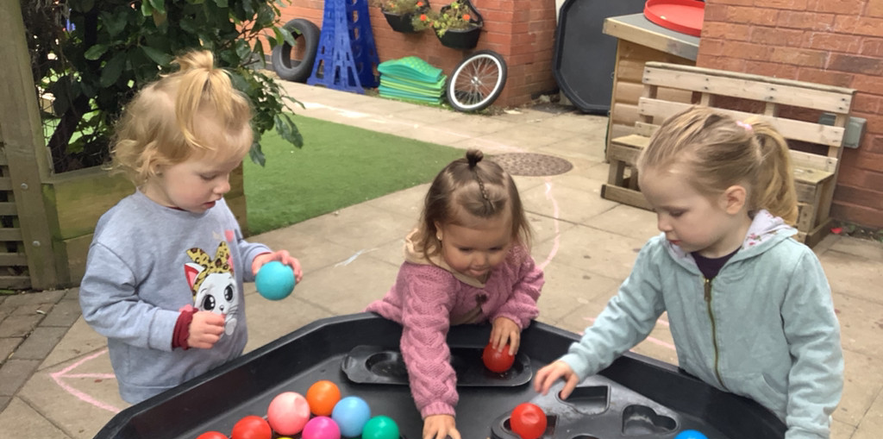
The Quality of Education
Strengths
Experienced staff knowledgeable in child development and identification of next steps
Data snapshots completed x3 a year show that children with EAL and EYPP perform in line with their peers across most areas of development
Focus child reports completed each term in collaboration with parents. These show progress for all pupils
Adapted curriculum for those pupils with specific learning differences in collaboration with external agencies
Curriculum is an intrinsic part of annual training plan for staff
Introduction of the WellComm language toolkit to support moderated, ambitious objectives in receptive and expressive language
Broad curriculum opportunities include:
Subject ‘champions’ lead a focus week on their area of development each year. Parents invited in
EYPP ‘life experience’ programme
Visits from local community workers
          Ofsted Report Jul 24:
Communication and language development are at the heart of all learning. Children, including those with SEND, select and choose books to share with familiar adults. In play, adults expand children’s verbal communication by echoing sentences with added detail.
Most adults at the school have a secure understanding of how young children learn and develop. They skilfully use opportunities to extend children’s thinking through play.
Adults model children’s ideas through print. This gives children a sense of pride
The ‘tiger room’ supports children with SEND to succeed and thrive alongside their peers. These children are provided with a curriculum that is well considered. It is precise and implemented very well. The school is ensuring that this precision is reflected in all its curriculum thinking.

Slide 7
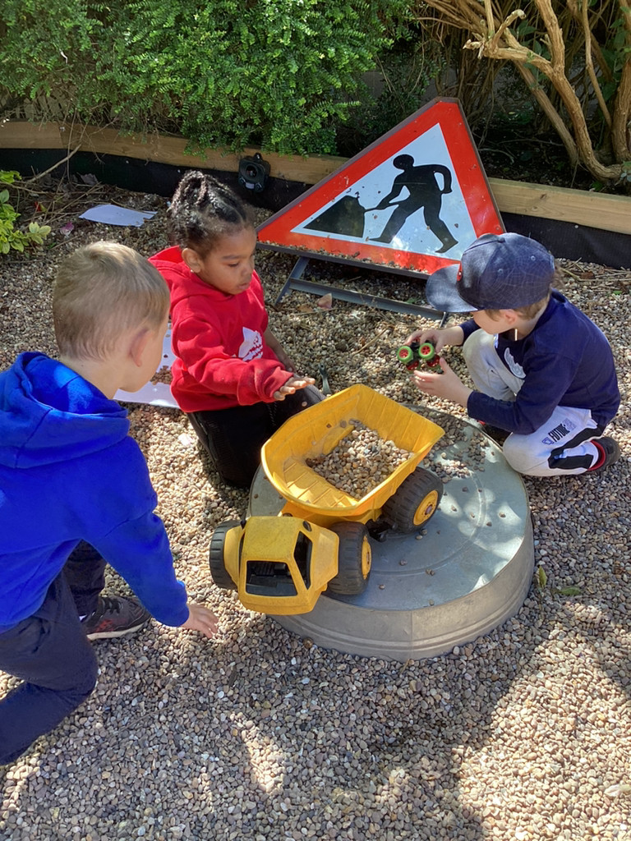
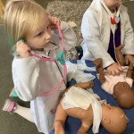
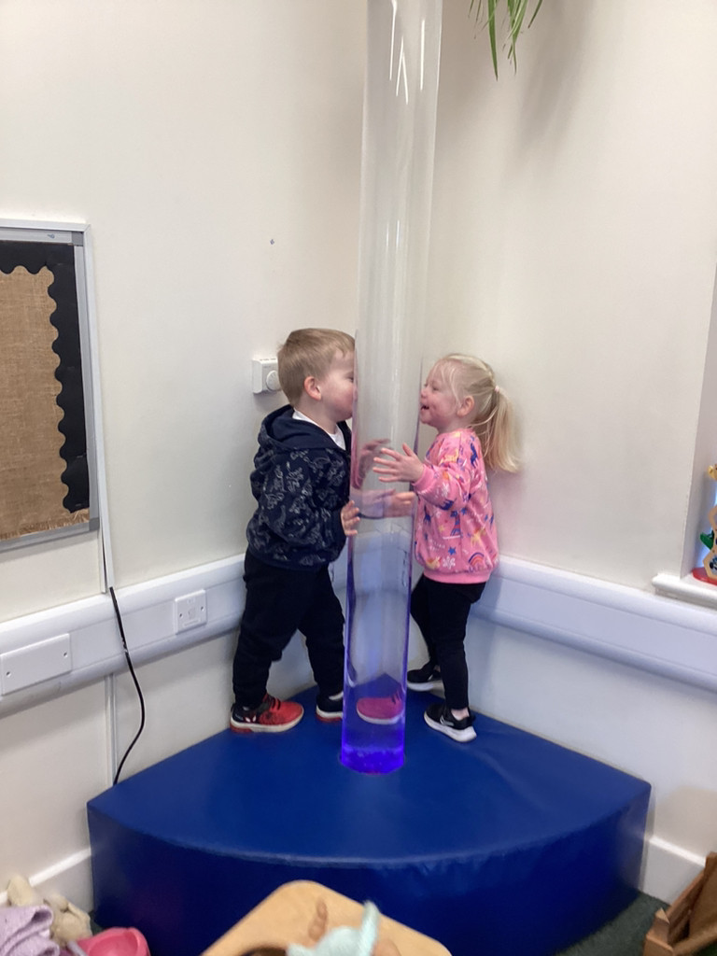
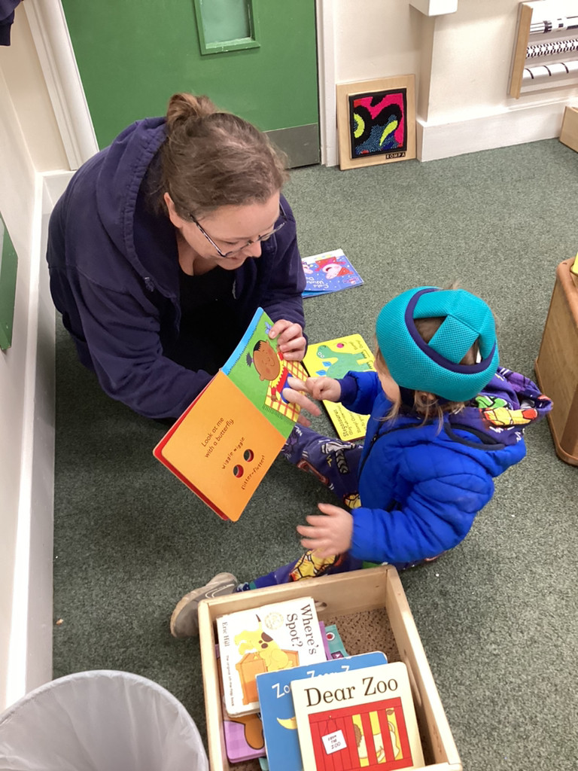
The Quality of Education
Areas to develop
GLD results July 2024:
National 67.7% of pupils achieved GLD at the end of Reception
Kettering 70.7% of pupils achieved GLD at the end of Reception
Ronald Tree 61% of pupils achieved GLD at the end of Reception
Marked difference to last year when we were higher than national figures. This data reflects the first year our SEND numbers grew rapidly. Since then we have introduced our new Tiger room and increased SEND staffing to better meet need.
Data snapshots throughout the year evidence that while progress is good, the areas of PSE & C&L are the lowest attaining subjects at Ronald Tree when pupils leave us for Reception. As Prime areas, it is essential that we work together to raise attainment in these areas of development.
Staff are not all aware of curriculum progression points and shared expectations. A revised curriculum and targeted monitoring will develop this next academic year. There will also be several new staff who will need to be trained.
Ofsted report 2024
A ‘year of experiences’ underpins the school’s curriculum. These are key opportunities that the school wants the children to have during their time at the nursery. These include opportunities to explore the locality, grow produce and understand different cultures, traditions and festivals. These experiences sit alongside the school’s curriculum, which outlines what children should learn, know and be able to recall with increasing independence. However, the school’s work to weave these experiences into a more precise and refined curriculum, which includes the two-year-old provision, is not yet complete.

Slide 8
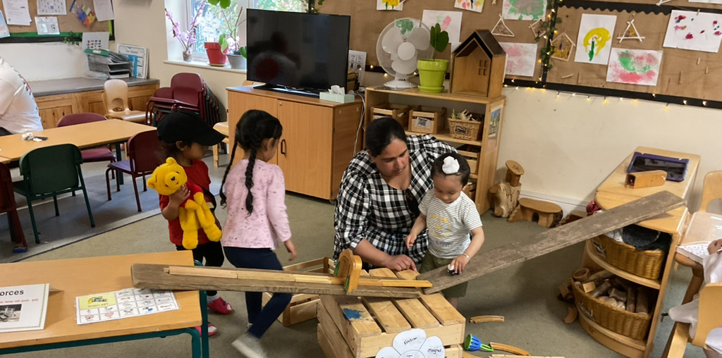
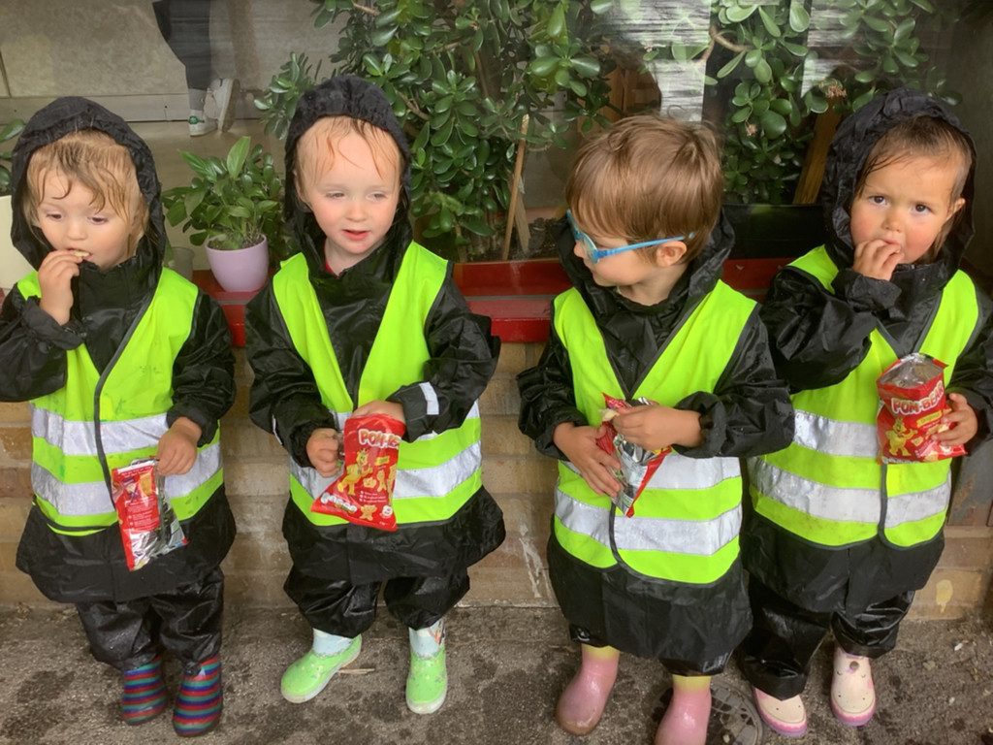
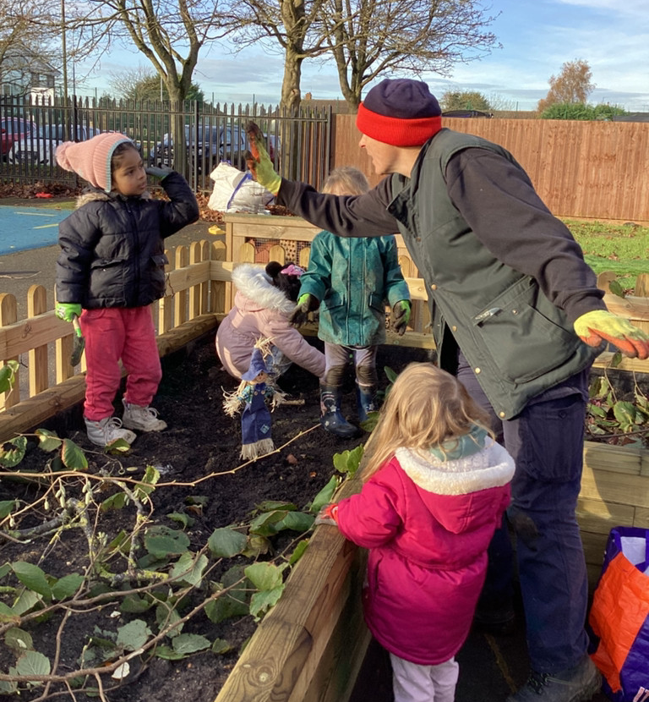
Personal Development
Ofsted Report 2024:
All children learn to respect and celebrate each other’s differences. They learn how to be thoughtful and caring towards each other. The ‘tiger room’ supports children with SEND to succeed and thrive alongside their peers.
Children feel safe because the nursery environment is welcoming and harmonious.
.
Personal Development is a real strength of our school.
We share 5 Ronald Tree Values; ‘The 5 Cs’ – Confidence, Consideration, Collaboration, Curiosity, Creativity. These run through our curriculum, our behaviour policy, our work with families and our everyday expectations. They link with British Values and Citizenship.
Varied and fun enrichment opportunities are planned for all children as part of ‘The Knowledge’ at Ronald Tree. Additionally, we have our weekly ‘Life Experiences’ aimed at pupils in receipt of EYPP funding. These are run by our dedicated FSW & an EYA to provide children with smaller ‘family size’ group events such as regular visits to The Green Patch, Cooking lessons, Walks to local shops to buy resources and ‘Cinema’ treats in the Community Centre. Each Term, families are invited to join their children in these groups to share the learning and build connections.
We teach ‘in the moment’ with our children, building individual curriculums and pathways to support holistic development, always starting with the PSE Area of Development and building from there. Key workers know their children incredibly well and work closely with families addressing all aspects of Early Years Education such as toileting, sleep support, hygiene and food choices.
Monitoring of assessment data and individual Focus Child Reports show significant progress in pupils’ PSE development.
Area to develop: Many pupils arrive at Ronald Tree in need of additional support to self-regulate when faced with big emotions and social situations. We will model co-regulation skills and continue to monitor trends and individuals to better meet specific needs to ensure all children feel safe and have strategies to support positive relationships

Slide 9
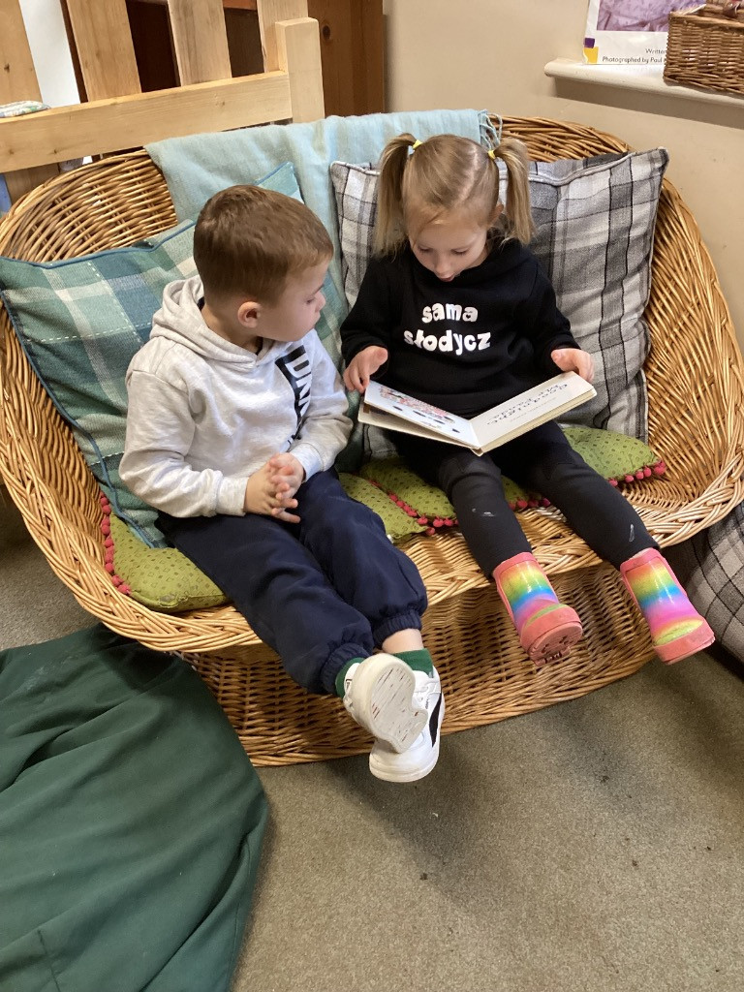
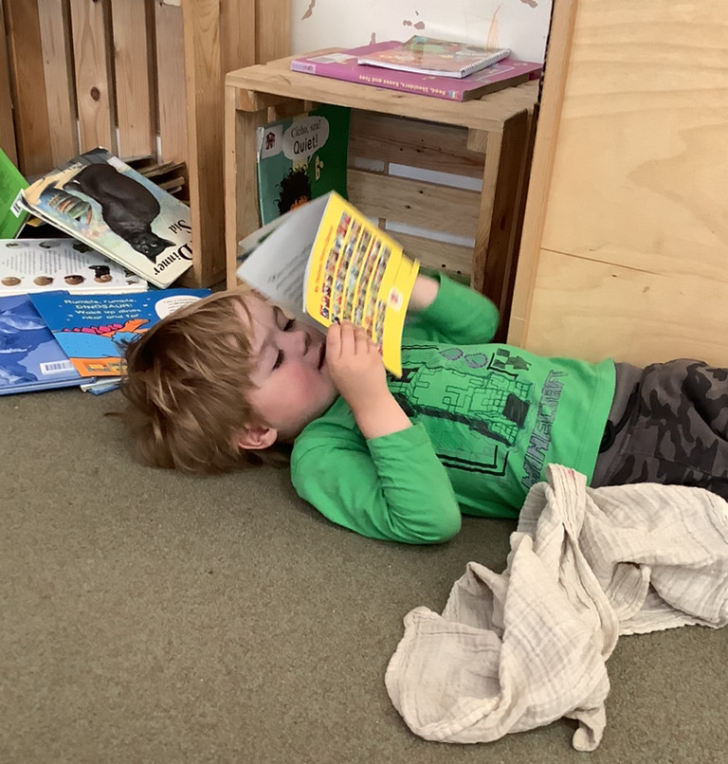
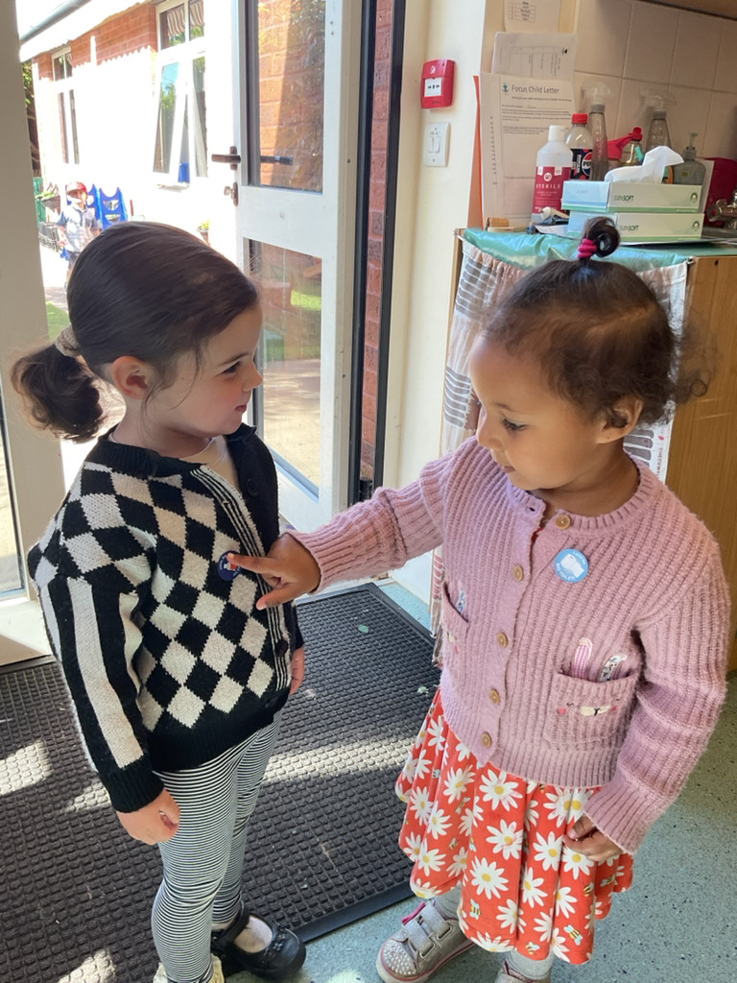
Behaviour and Attitudes
OFSTED Report Jul 24:
Adults model using positive language. This enables children, including those with SEND, to express their emotions and needs in an appropriate way. They learn to understand how their actions can have an impact on their peers and their feelings. This has reduced incidents of falling out. Any issues are quickly resolved so that children can get on with their learning.
.
Strengths
All teaching staff attended Team Teach training and training in The Solihull Approach to ensure a shared approach to managing behaviour at Ronald Tree
The school behaviour log has moved to My Concern. Records are kept electronically and can be monitored and analysed to recognise trends and individual concerns.
Staff are proactive in identifying challenging behaviour patterns and act quickly to work with families and make changes to the environment to offer better support.
The creation of our Tiger Room; an adapted play space for those children with additional needs and who struggle with behaviour in the busy main nursery rooms has been a huge success. Budget has been used to employ additional staff with SEND experience and many of the techniques we started using with our ‘Tigers’ such as communication boards and visual cues, have become common practice across the entire setting.
Pupils are supported to take pride in themselves through positive language, specific praise and encouragement to keep trying until they achieve what they set out to do. Risk taking and collaborative play is actively encouraged to build resilience, commitment and pride.
We follow regular routines to enable pupils to feel secure and ‘at home’ while with us. There are a lot of us, so we use tambourines, drums, songs and rhythms to gain attention rather than raising our voices. All staff consistently model positive behaviour and affirmative language.
Areas to develop:
We have a large, bustling environment. Children need extra guidance to treat resources respectfully and to better tidy and take pride in the setting.
Attendance is not compulsory for Nursery aged children. We have not yet agreed on specific procedures to address persistent absentees which support the child to return to school without parents feeling pressured and exercising their right to withdraw their child from the setting.

Slide 10
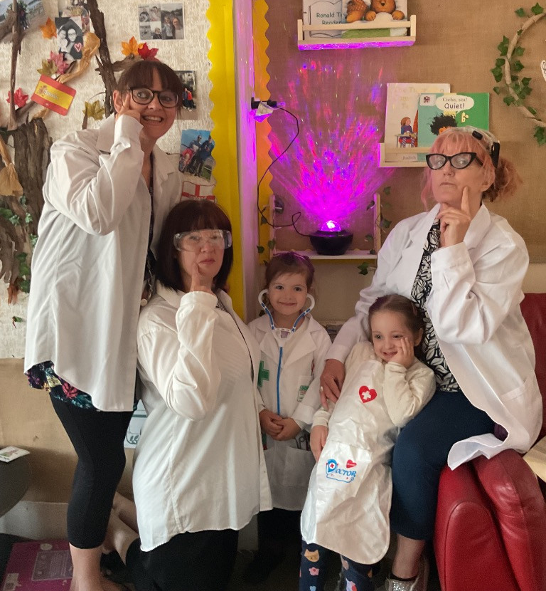
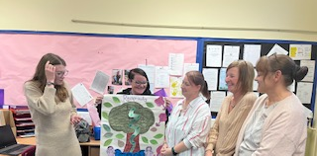
Leadership and Management
OfSTED Report Jul 2024:
Staff appreciate the efforts made by leaders to support their well-being and workload. They feel these actions are having a positive impact on their work-life balance
Governors are passionate about their vision for the nursery. They want to ensure that the school continues to meet the needs of the local community
Strengths
We are a small, passionate team at Ronald Tree. As such, we work as collaboratively as possible to create our vision and ensure it lives and breathes every day.
Staff supervision is timetabled x3 a year. This was introduced this academic year and has quickly proven itself to be an effective tool to support staff individually.
Staff CPD is chosen to meet the needs of the team. All teaching staff have achieved their accreditation in The Solihull Behaviour approach and subject champions have provided online learning and thought-provoking questions as part of their role.
The Spring staff well-being survey showed staff had high levels of pride, understanding and confidence in their roles.
The consideration of work-life balance is taken very seriously. Wherever possible, PPA can be taken from home and all staff are entitled to a ‘Well-Being Day’ each academic year. One training day each year is given over to playfulness and team building.
Extensive links with external agencies underpin the work we do here. Portage, HomeStart, Local Primary Schools, Social Services, Police.
Despite several key titles being held by the head, Ronald Tree works most effectively by utilising teams, to ensure support, shared understanding and collaboration in all the essential components of school life. Team meetings are scheduled weekly.
Our Governors are supportive but challenge us and have a clear understanding of what the school need to do to improve further. Records of meetings, visits and documentation are kept on Governor Hub.
Areas to develop:
More robust monitoring of the curriculum by head and teacher to ensure implementation is consistent and effective
Staff CPD to support resilience and professional relationships

Slide 11
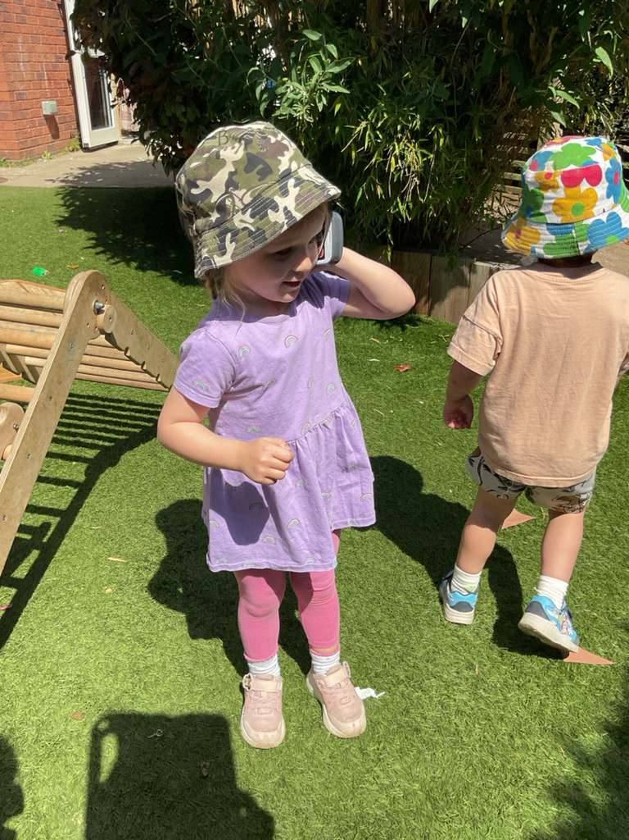

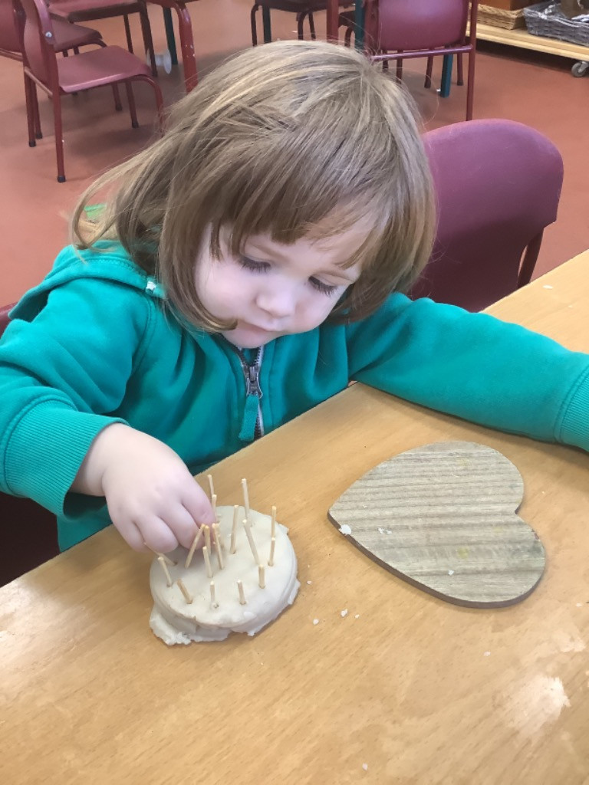
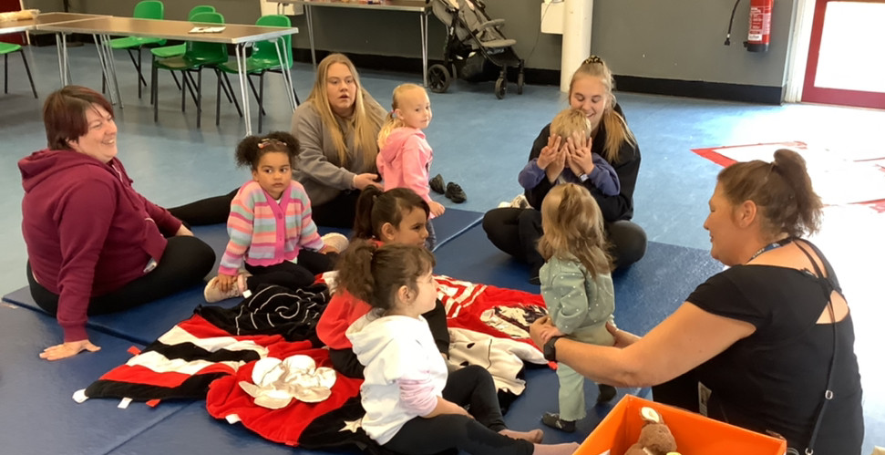
Leadership and Management
Safeguarding focus
Safeguarding remains a strength of the school. Staff know their families well and are confident in our procedures.
Our Jul 2024 Ofsted report recorded safeguarding as effective in the school.
All concerns are recorded by staff onto MyConcern and the safeguarding team meet weekly to triage these and share any actions they may have taken as a result.
This year’s lockdown drills were conducted effectively with consideration for the young age of our pupils. Several actions were identified and addressed as a result, including the installation of new security gates to access the setting.
We work with many agencies to support the families in our care.
The Family Support worker has built excellent links to local services and runs a weekly ‘drop-in’ and targetted PEEP sessions for families at the adjacent community centre.
Regular H&S walks are carried out with the head & SBM and reported to Governors.
External audits show full compliance
Safeguarding in Education
This year, we opted to seek advice from our local Safeguarding in Education partners in light of our concerns over partnership working.
A safeguarding review was conducted jointly with the SIE team, our School Improvement Partner and ourselves. This was a mostly positive experience, highlighting the excellent practice here at Ronald Tree and supporting us to identify and resolve some areas of development required in recording incidents and in staff training.
This has resulted in better online reporting procedures for pupil injuries and accidents in the setting and improved risk assessments of daily activities and resources.

Slide 12
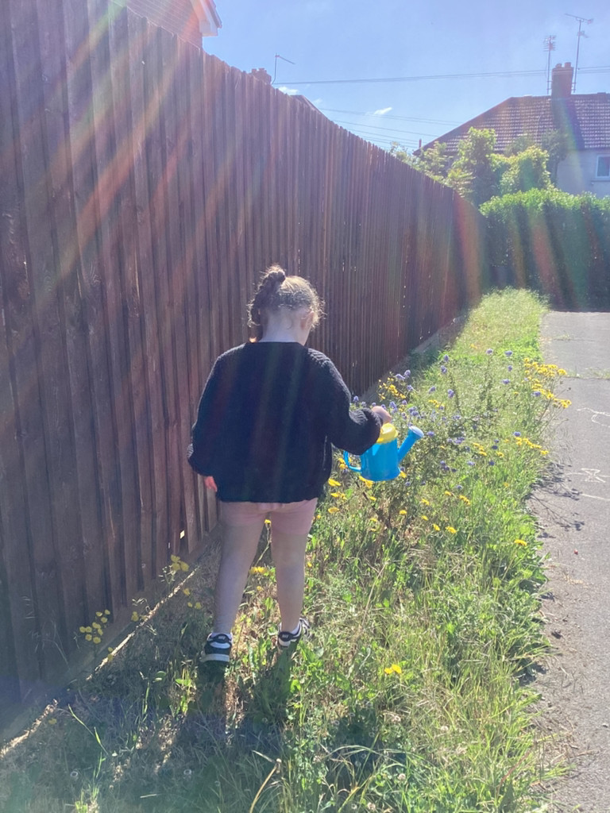
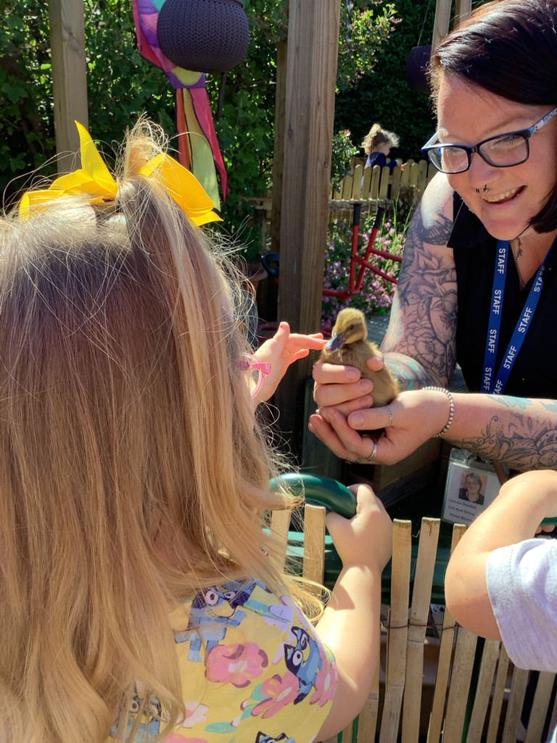
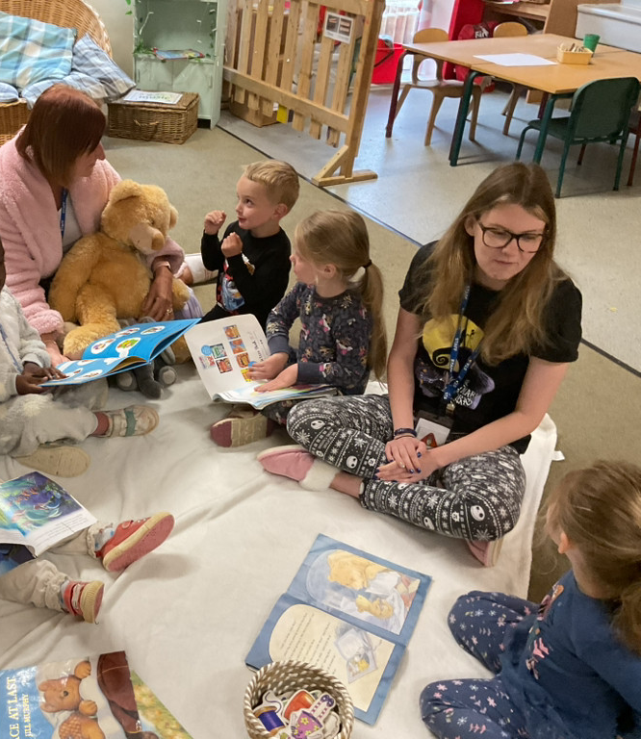
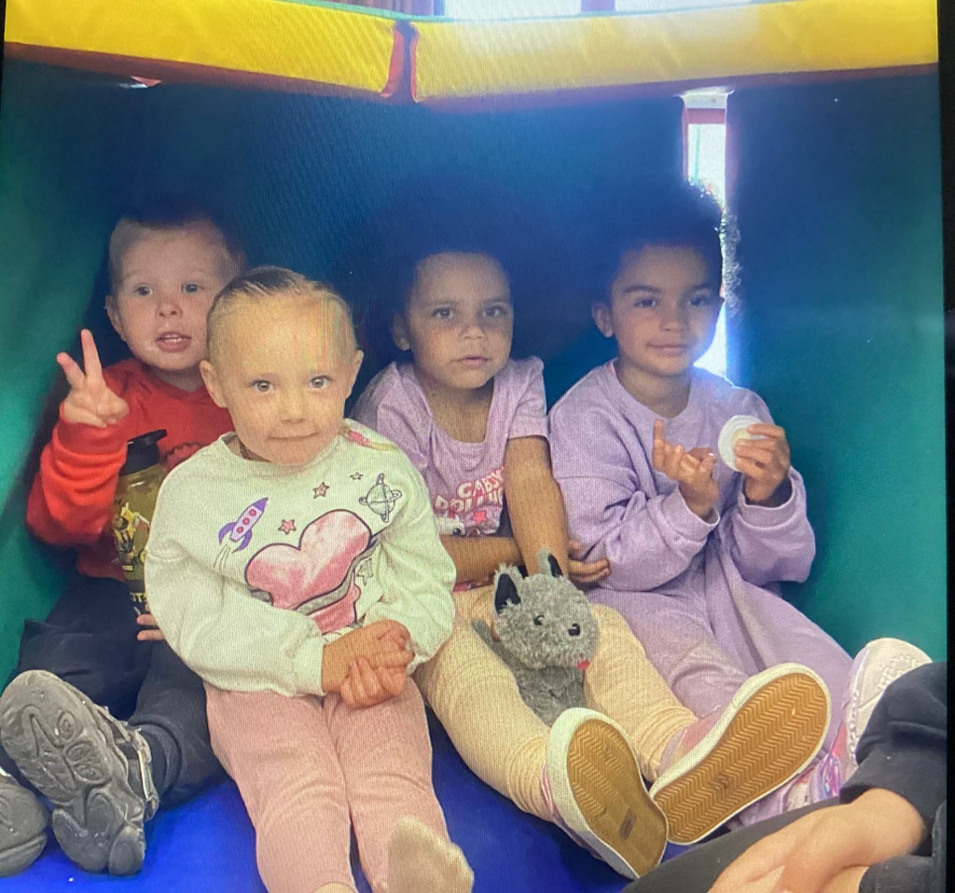
Thank you

